Slide 1
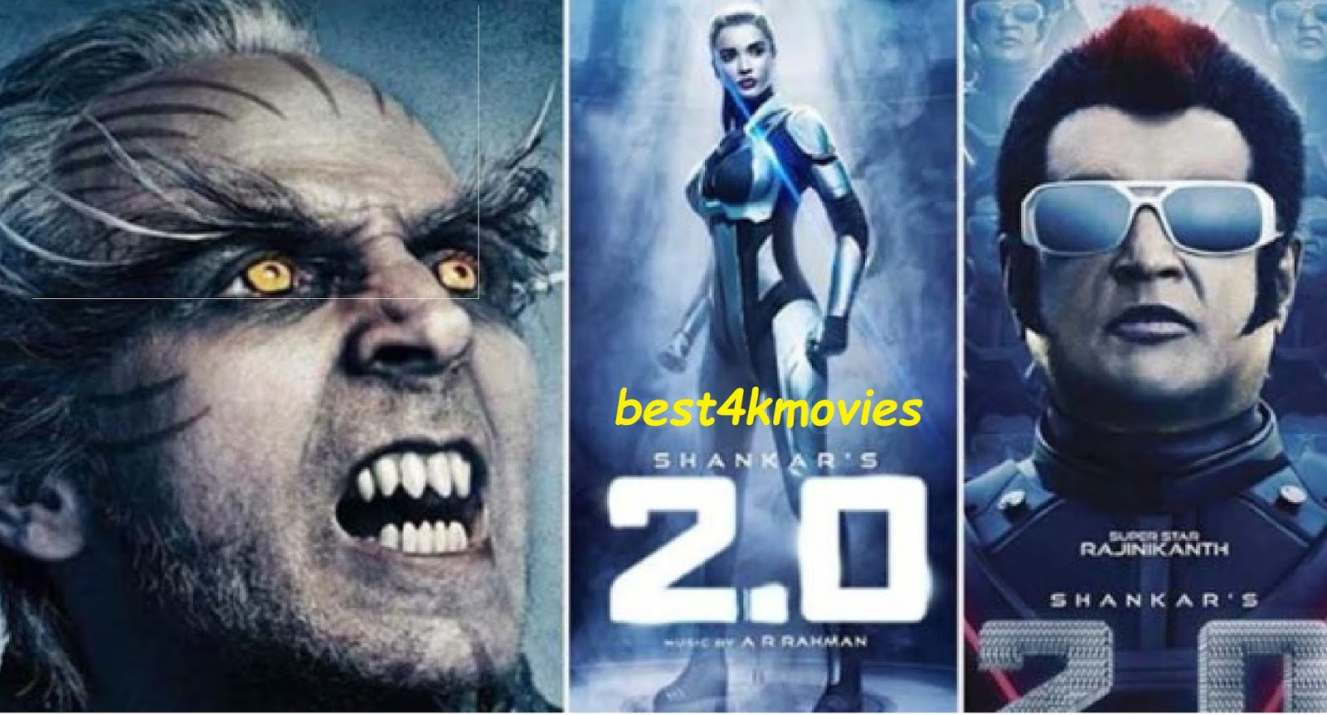
Intelligent Agents
Chapter 2

Slide 2
Outline
Agents and environments
Rationality
PEAS (Performance measure, Environment, Actuators, Sensors)
Environment types
Agent types

Slide 3
Agents
An agent is anything that can be viewed as perceiving its environment through sensors and acting upon that environment through actuators
Human agent: eyes, ears, and other organs for sensors; hands
legs, mouth, and other body parts for actuators
Robotic agent: cameras and infrared range finders for sensors;
various motors for actuators

Slide 4
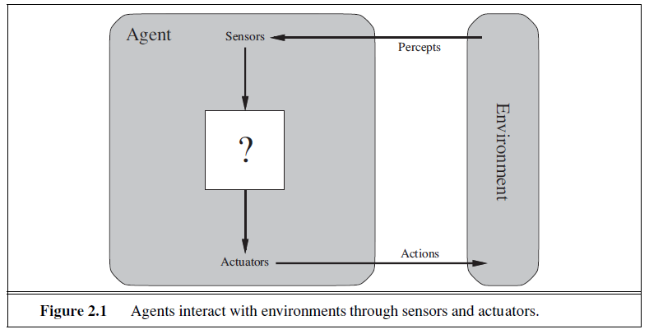

Slide 5
Agents and Objects
Are agents just objects by another name?
Object:
  encapsulates some state
  communicates via message passing
  has methods, corresponding to operations that may be performed on this state

Slide 6
Agents and Objects
Main differences:
  agents are autonomous:
  agents embody stronger notion of autonomy than objects, and in particular, they decide for themselves whether or not to perform an action on request from another agent
  agents are smart:
  capable of flexible (reactive, pro-active, social) behavior, and the standard object model has nothing to say about such types of behavior
  agents are active:
  a multi-agent system is inherently multi-threaded, in that each agent is assumed to have at least one thread of active control

Slide 7

Agents and environments
The agent function maps from percept histories to actions:
[f: P* → A]
The agent program runs on the physical architecture to produce f
agent = architecture + program

Slide 8
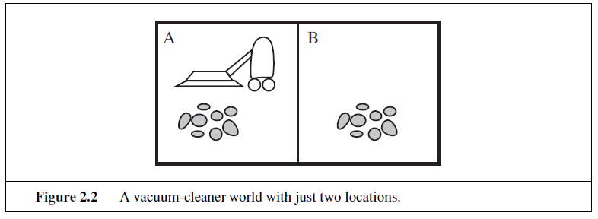

Slide 9
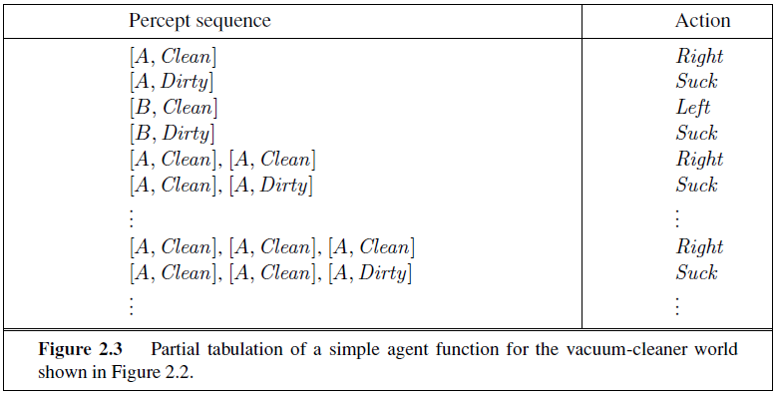

Slide 10

Vacuum-cleaner world
Percepts: location and contents, e.g., [A,Dirty]
Actions: Left, Right, Suck, NoOp

Slide 11
Rational agents
An agent should strive to "do the right thing", based on what it can perceive and the actions it can perform. The right action is the one that will cause the agent to be most successful
Performance measure: An objective criterion for success of an agent's behavior
E.g., performance measure of a vacuum-cleaner agent could be amount of dirt cleaned up, amount of time taken, amount of electricity consumed, amount of noise generated, etc.

Slide 12
Rational agents
Performance measure: An objective criterion for success of an agent's behavior
E.g., performance measure of a vacuum-cleaner agent could be
  amount of dirt cleaned up,
  amount of time taken,
  amount of electricity consumed,
  amount of noise generated, etc.

Slide 13
Rational agents
Rational Agent: For each possible percept sequence, a rational agent should select an action that is expected to maximize its performance measure, given the evidence provided by the percept sequence and whatever built-in knowledge the agent has.

Slide 14
Rational agents
Rationality is distinct from omniscience (all-knowing with infinite knowledge)
Agents can perform actions in order to modify future percepts so as to obtain useful information (information gathering, exploration)
An agent is autonomous if its behavior is determined by its own experience (with ability to learn and adapt)

Slide 15
Rational agents
What is rational at any given time depends on four things:
The performance measure that defines the criterion of success.
The agent’s prior knowledge of the environment.
The actions that the agent can perform.
The agent’s percept sequence to date.

Slide 16
PEAS
PEAS: Performance measure, Environment, Actuators, Sensors
Must first specify the setting for intelligent agent design
Consider, e.g., the task of designing an automated taxi driver:
  Performance measure
  Environment
  Actuators
  Sensors

Slide 17
PEAS
Must first specify the setting for intelligent agent design
  Performance measure: Safe, fast, legal, comfortable trip, maximize profits
  Environment: Roads, other traffic, pedestrians, customers
  Actuators: Steering wheel, accelerator, brake, signal, horn
  Sensors: Cameras, sonar, speedometer, GPS, odometer, engine sensors, keyboard
Consider, e.g., the task of designing an automated taxi driver:

Slide 18
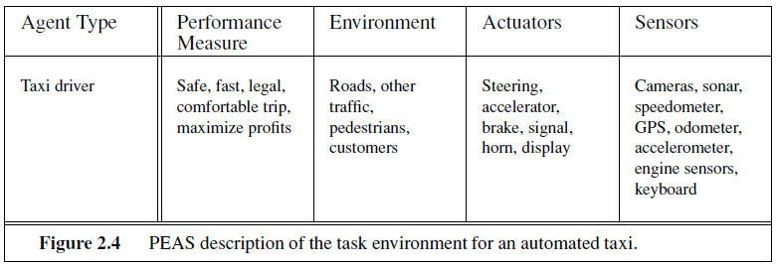

Slide 19
PEAS
Agent: Medical diagnosis system
Performance measure: Healthy patient, minimize costs, lawsuits
Environment: Patient, hospital, staff
Actuators: Screen display (questions, tests, diagnoses, treatments, referrals)
Sensors: Keyboard (entry of symptoms, findings, patient's answers)

Slide 20
PEAS
Agent: Part-picking robot
Performance measure: Percentage of parts in correct bins
Environment: Conveyor belt with parts, bins
Actuators: Jointed arm and hand
Sensors: Camera, joint angle sensors

Slide 21
PEAS
Agent: Interactive English tutor
Performance measure: Maximize student's score on test
Environment: Set of students
Actuators: Screen display (exercises, suggestions, corrections)
Sensors: Keyboard

Slide 22
PEAS
How about an Internet shopping agent?
Performance measure: Price, quality, appropriateness, efficiency, . . .
Environment: Current and future Web sites, vendors, shippers, . . .
Actuators: Display to user, follow URL, fill in form . . .
Sensors: Web pages (text, graphics, scripts. . .)

Slide 23
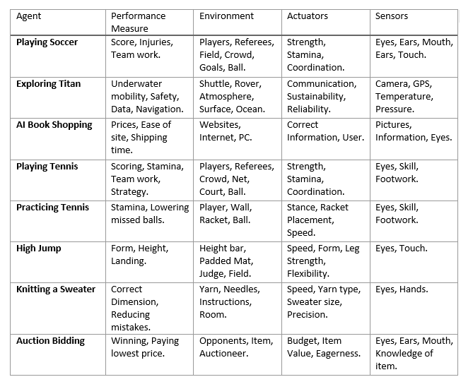
PEAS

Slide 24
Environment types
Fully observable (vs. partially observable): An agent's sensors give it access to the complete state of the environment at each point in time.
Deterministic (vs. stochastic): The next state of the environment is completely determined by the current state and the action executed by the agent. (If the environment is deterministic except for the actions of other agents, then the environment is strategic)
Episodic (vs. sequential): The agent's experience is divided into atomic "episodes" (each episode consists of the agent perceiving and then performing a single action), and the choice of action in each episode depends only on the episode itself.

Slide 25
Environment types
Static (vs. dynamic): The environment is unchanged while an agent is deliberating. (The environment is semidynamic if the environment itself does not change with the passage of time but the agent's performance score does)
Discrete (vs. continuous): A limited number of distinct, clearly defined percepts and actions.
Single agent (vs. multiagent): An agent operating by itself in an environment.

Slide 26
Environment types
Chess with Chess without
a clock a clock
Fully observable Yes Yes
Deterministic Strategic Strategic
Episodic No No
Static Semi Yes
Discrete Yes Yes
Single agent No No
The environment type largely determines the agent design
The real world is (of course) partially observable, stochastic, sequential, dynamic, continuous, multi-agent

Slide 27
Environment example
Crossword puzzle:
  Observable:
  Agents:
  Deterministic:
  Episodic:
  Static:
  Discrete:

Slide 28
Environment example
  Crossword puzzle:
    Observable: Fully
    Agents: Single
    Deterministic: Deterministic
    Episodic: Sequential
    Static: Static
    Discrete: Discrete

Slide 29
Environment example
Taxi Driver:
  Observable:
  Agents:
  Deterministic:
  Episodic:
  Static:
  Discrete:

Slide 30
Environment example
  Taxi Driver:
    Observable: Partially
    Agents: Multi
    Deterministic: Stochastic
    Episodic: Sequential
    Static: Dynamic
    Discrete: Continuous

Slide 31
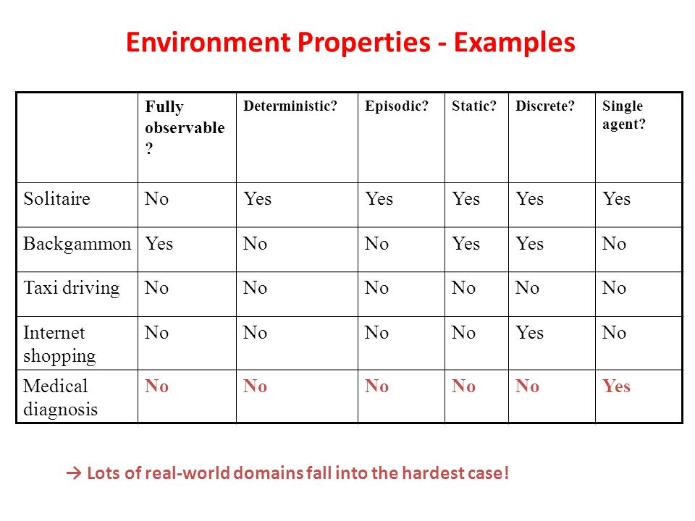
Environment example

Slide 32
Agent functions and programs
An agent is completely specified by the agent function mapping percept sequences to actions
One agent function (or a small equivalence class) is rational
Aim: find a way to implement the rational agent function concisely

Slide 33
Table-lookup agent
\input{algorithms/table-agent-algorithm}
Drawbacks:
  Huge table
  Take a long time to build the table
  No autonomy
  Even with learning, need a long time to learn the table entries

Slide 34
Agent types
Four basic types in order of increasing generality:
Simple reflex agents
Model-based reflex agents
Goal-based agents
Utility-based agents

Slide 35

Simple reflex agents

Slide 36

Model-based reflex agents

Slide 37

Goal-based agents

Slide 38

Utility-based agents

Slide 39

Learning agents

